Slide 1
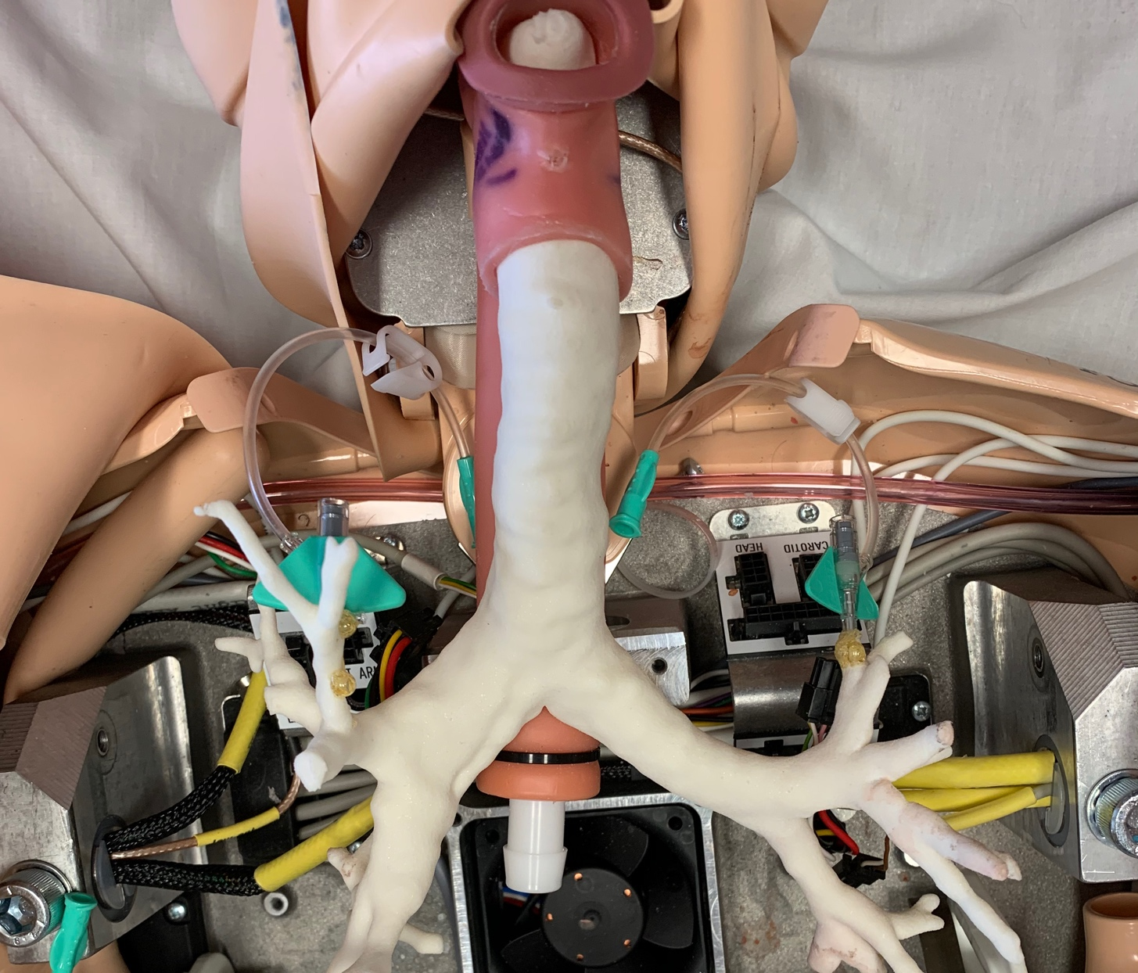
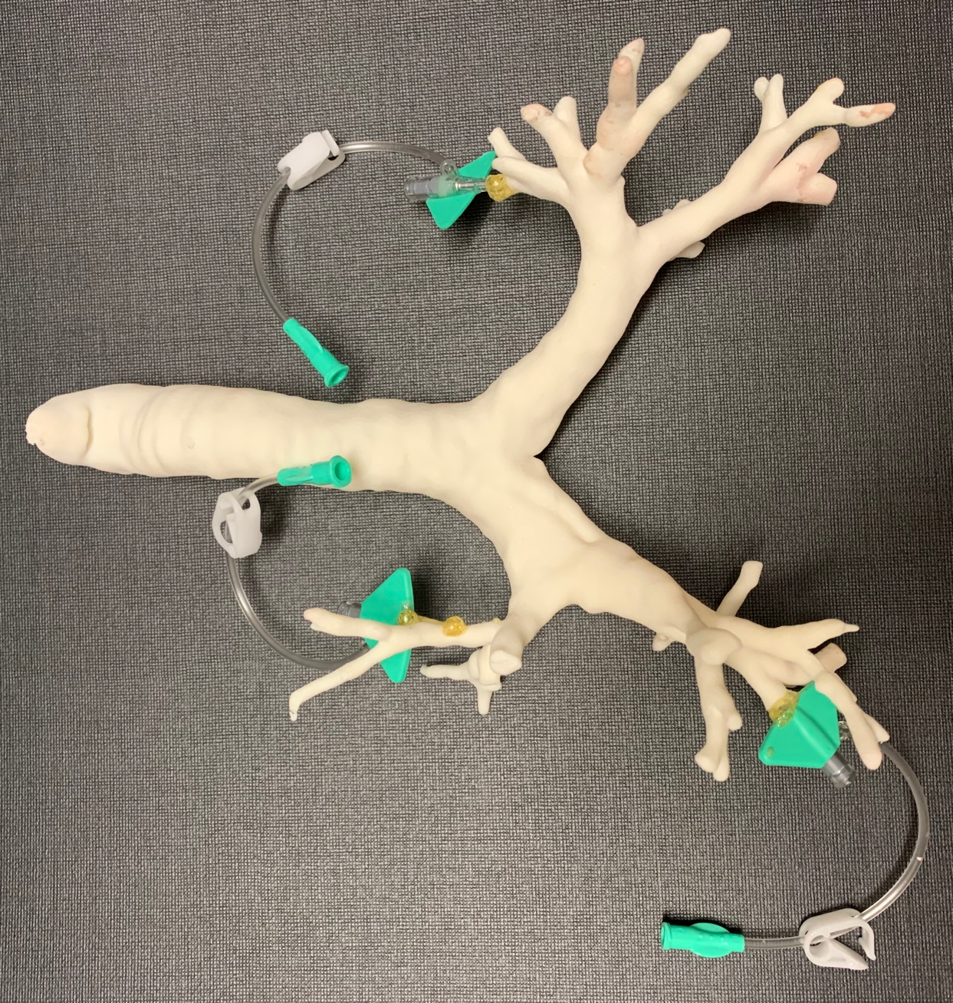
A
B
C
Figure 1. High-Fidelity Hemoptysis Simulator. A. 3-D printed lower airway model with three sites where fake blood could be inserted into the model via intravenous (IV) tubing. B. The lower airway model connected to the SimMan 3G upper airway. C. Fellows practice the management of massive hemoptysis using the simulator, including intubation, bronchoscopy and placement of endobronchial blocker.

